Slide 1
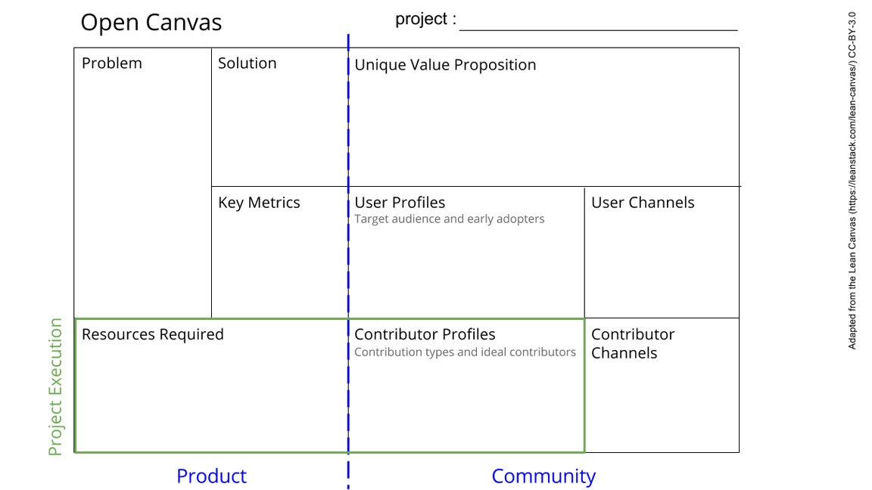
Commons for Academics Workshop
1- Lack of knowledge about commons among academics
2- Inefficiency in allocating common resources
3- Doers have too little say on the allocation
Organize a reproducible training workshop and spread the word
A convincing workshop and workflow for starting a commons project to solve a real life issue that is based on the academic knowledge about successful governance of commons
1 workshop with >20 participants
> 1 project on managing a commons
Organizing workshops and repeating those. Podcast as medium for communication
Academics, librarians, university administrators
Workshop material and speakers
Project(s) to actualize and communication channels for best practices
Experts in commons
Engaged users
Workshop organizers
Invitation before, during, and after the workshop
See next slide for instructions!
Notes:
Go to File > Make a Copy… to make your own canvas
See next slide for instructions

Slide 2
